Slide 1
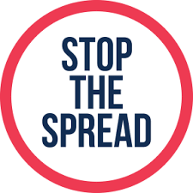
IMPORTANT INFORMATION FOR ALL ANGLERS
Before coming to our sites please ensure your clothing and
equipment has been thoroughly cleaned and dried to prevent the spread of invasive non-native plants, animals and disease
Invasive non-native species can seriously impact our fisheries by eating young fish, consuming food resources, and affecting water quality. Invasive species and fish diseases can easily be spread to our sites on damp clothing, muddy footwear and angling equipment.
To protect our fisheries from harmful invasive species, whenever you leave a site and
before entering another please follow the Check, Clean Dry procedure:
Check your clothing, footwear and equipment for mud, animal and plant material. Remove anything you find and leave it on-site.
Clean your kit thoroughly as soon as you can, paying particular attention to nets, waders and damp equipment. If possible use hot water and disinfectant to clean your kit, as this helps to remove hidden pests and disease.
Dry everything for as long as you can before using elsewhere, as some aquatic invasive plants and animals can survive for over two weeks in damp conditions.
These simple steps will help to prevent the spread of harmful invasive species into our fishery. Once introduced, invasive species are nearly impossible to remove, so we must all take steps to prevent their entry.
Watch out for
Crayfish
Plants
Shrimp
Mussels
For more information on invasive species and tips to protect your fisheries go to: nonnativespecies.org/checkcleandry

