Slide 1



User Manual
www.wayleadr.com

Slide 2
Set up your account
Accessing Wayleadr with Email/Password:
Click the link for your group to sign up to Wayleadr.
Choose Sign in with Email and create your password.
Password Requirements:
Minimum 10 characters
At least 1 lowercase letter
At least 1 uppercase letter
At least 1 number
At least 1 special character (?, #, $, !)
Download the Wayleadr App:
Android app: Link
Apple app: Link
Web link: app.wayleadr.com
1.

Slide 3
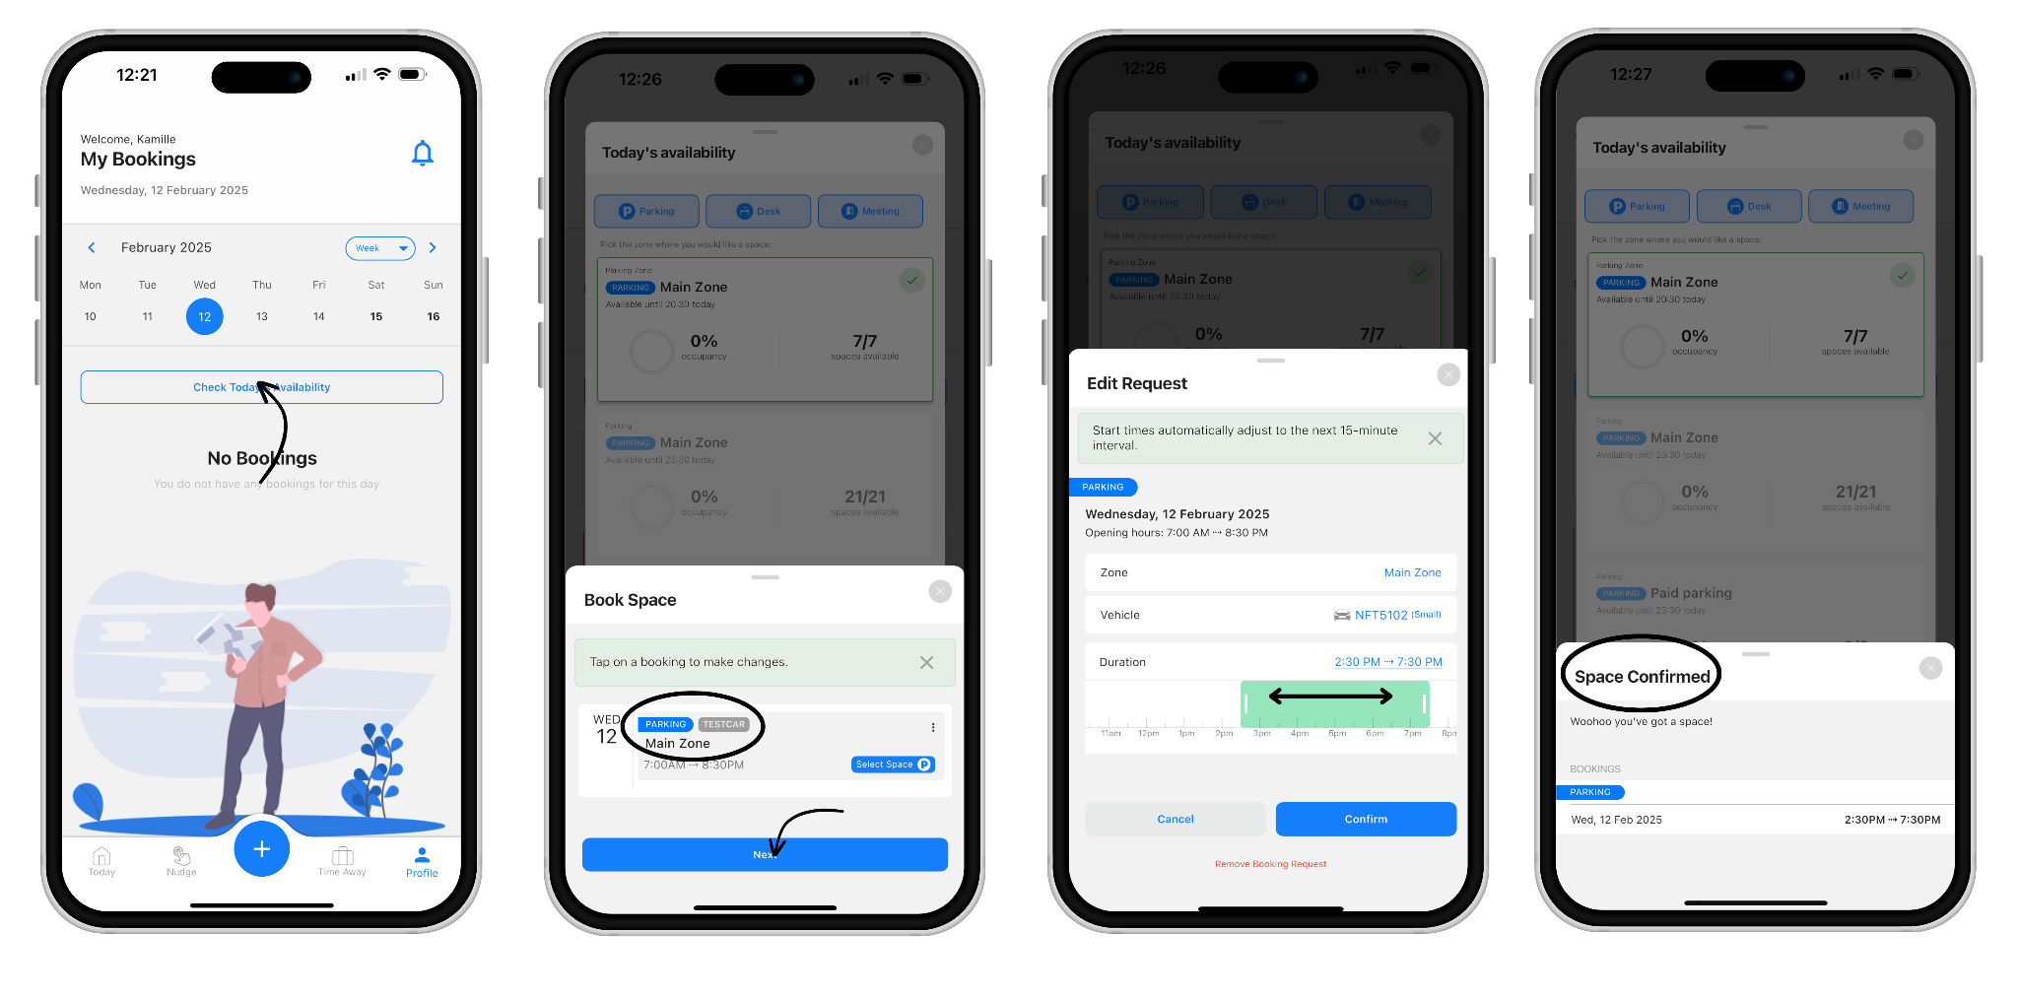
How do I pre-book a space?
Request the days you need a space up to 2 weeks in advance.
Click the booking tile to adjust your start and end time using the slider. The minimum booking length is set to 6.5 hours.
Once submitted your booking request will appear as Pending.

Slide 4
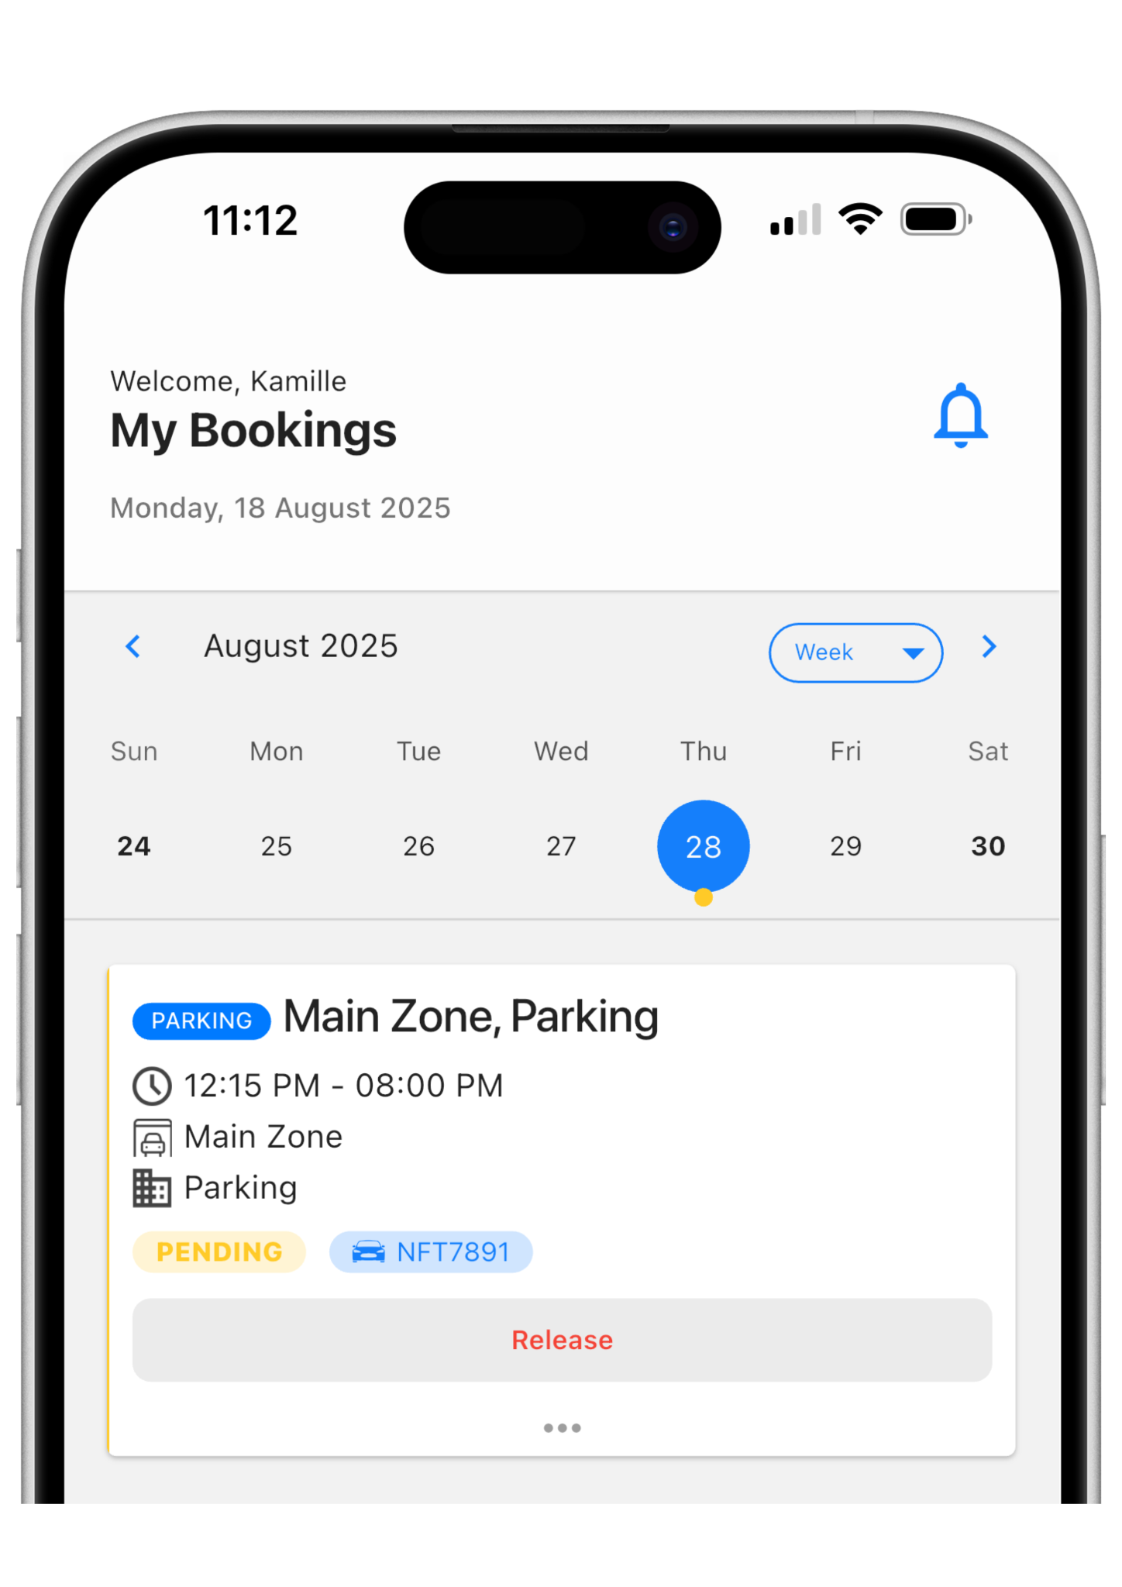
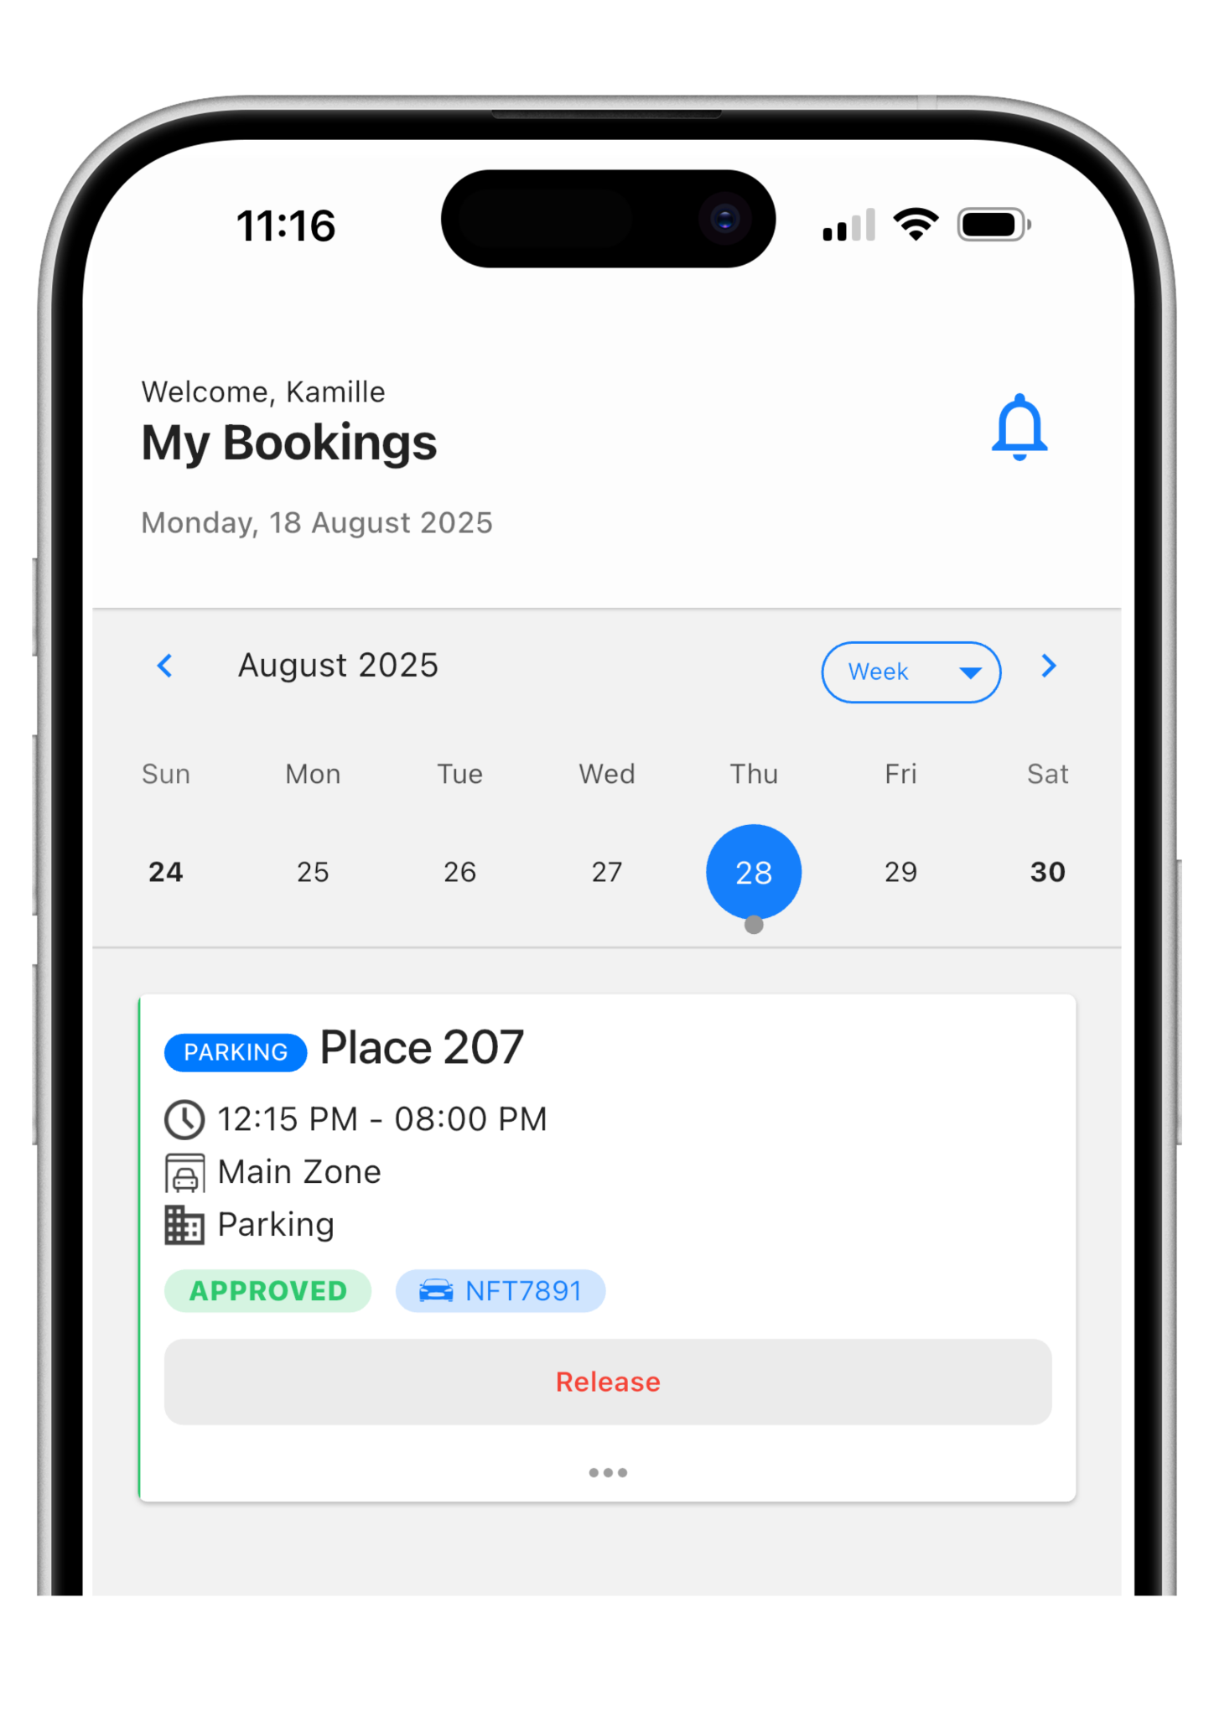
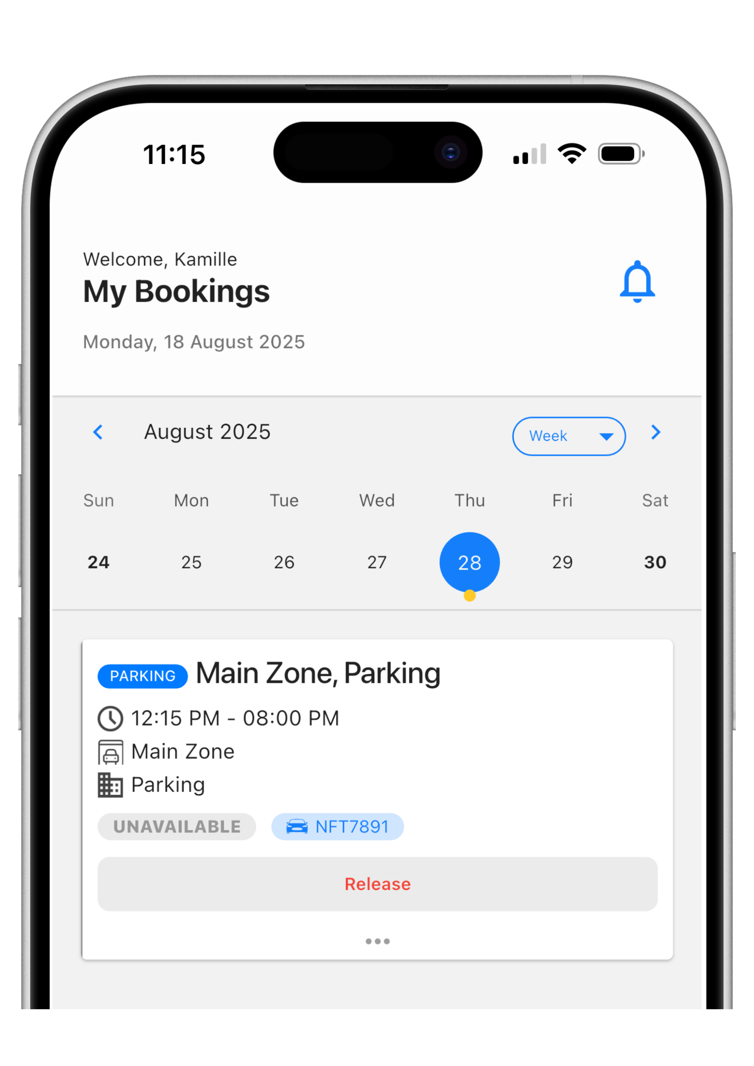
Pending Bookings
Your booking request will appear as pending until the allocation runs every Friday at 1pm. At this time you will receive an email notification advising you of your spaces for the following week.
Pending Booking
You’ll receive a notification when this booking has been processed
Approved Booking
Your booking will show in green as approved, along with your assigned spot (if numbered).
Unavailable Booking
If you were unsuccessful in obtaining a spot, your request still remains on the waitlist in the event that someone releases their space

Slide 5

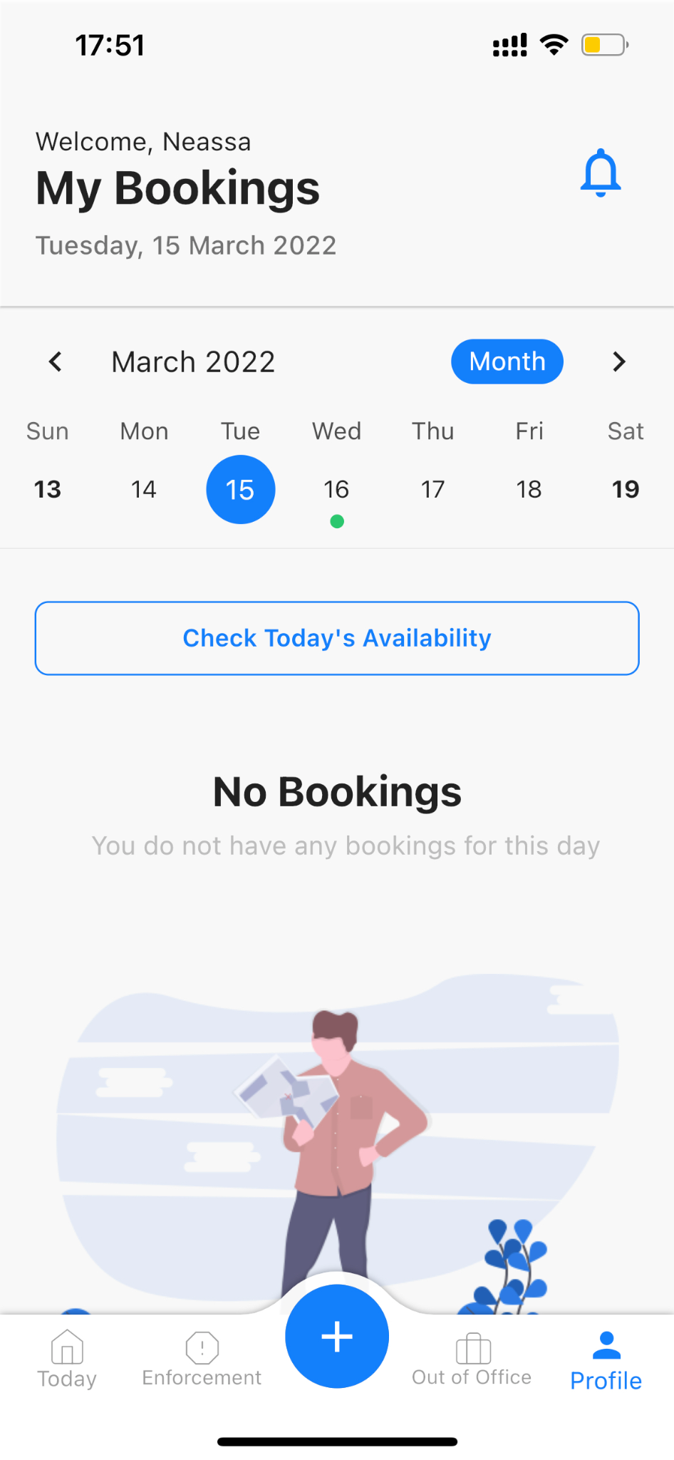
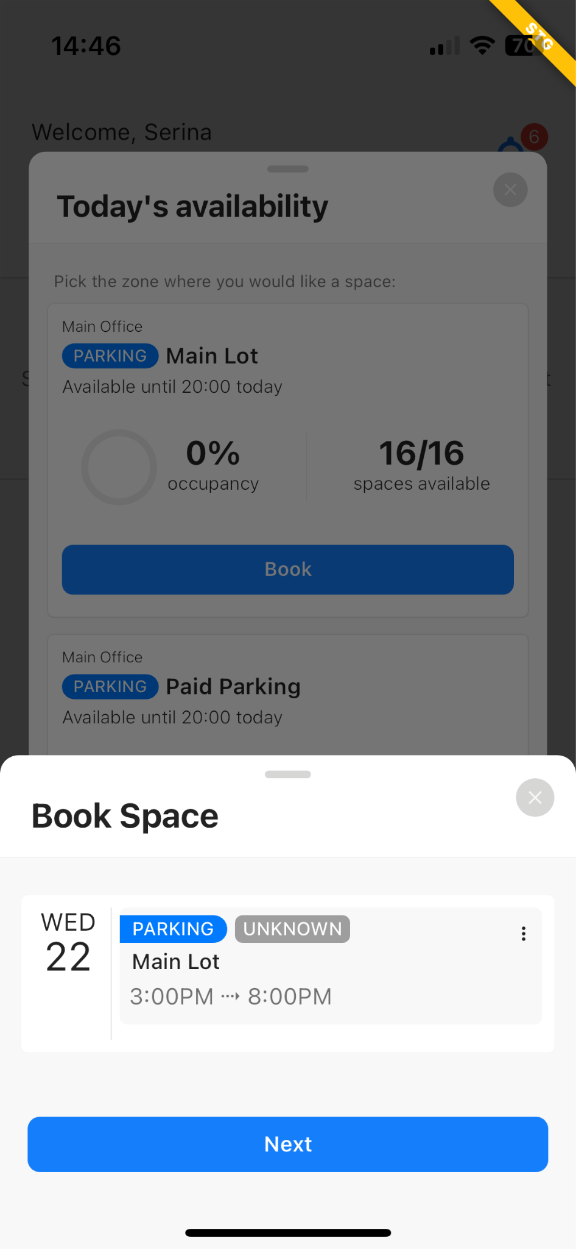
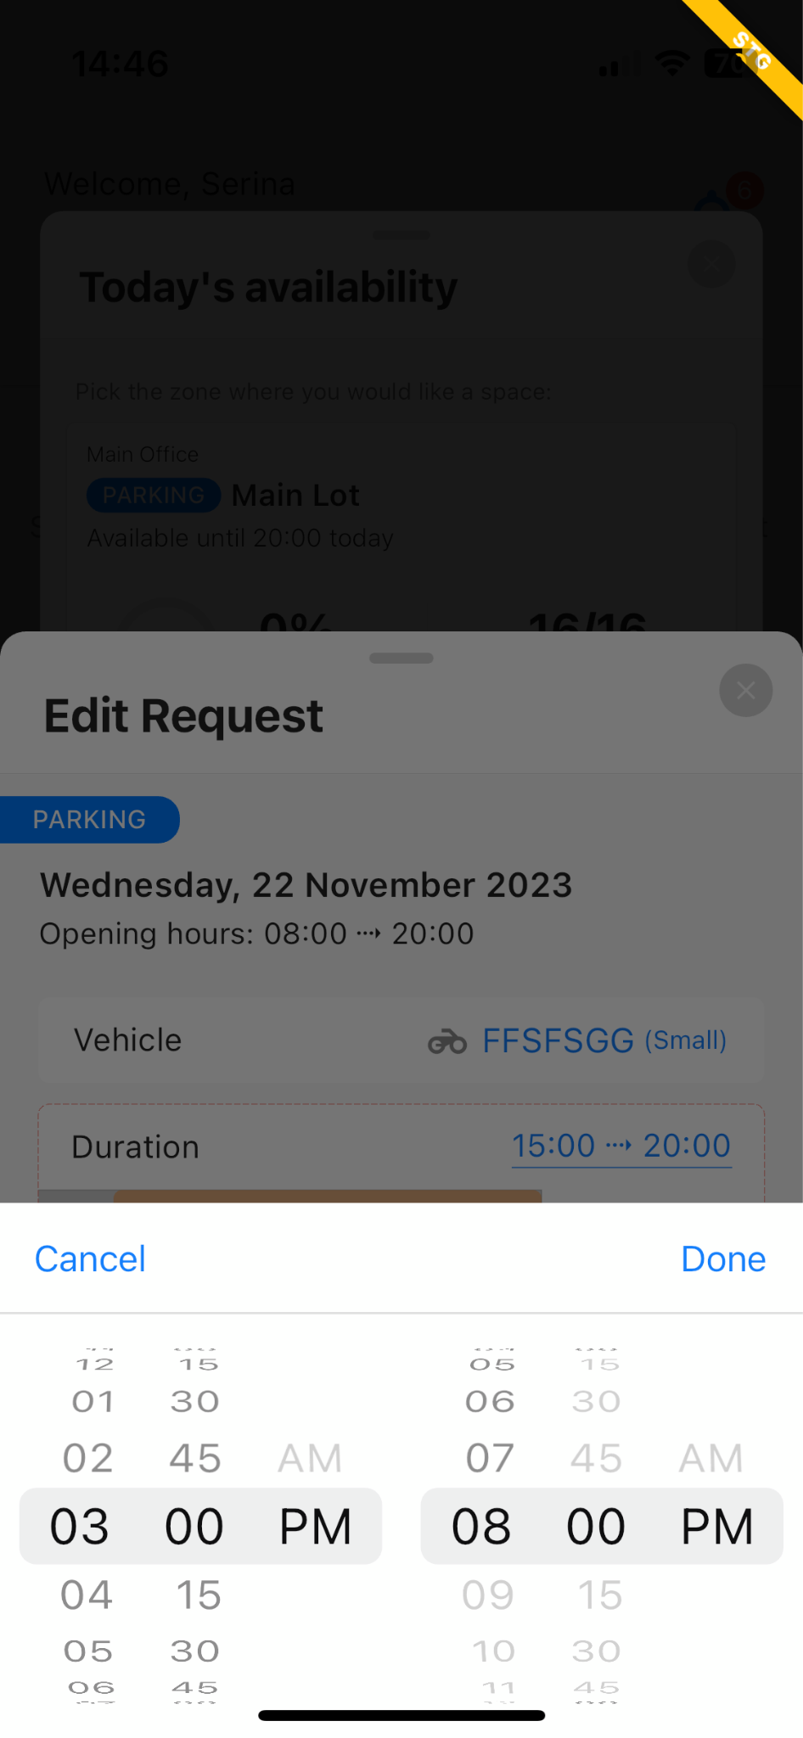

Can I book a space on the day?
Yes, you can instant book a spot by simply clicking the “Check Today’s Availability” button
If a space is available, click “Book.” On the day you will be able to book into additional spaces if they are not in use by other groups onsite.
You will instantly receive your space details!
www.wayleadr.com

Slide 6
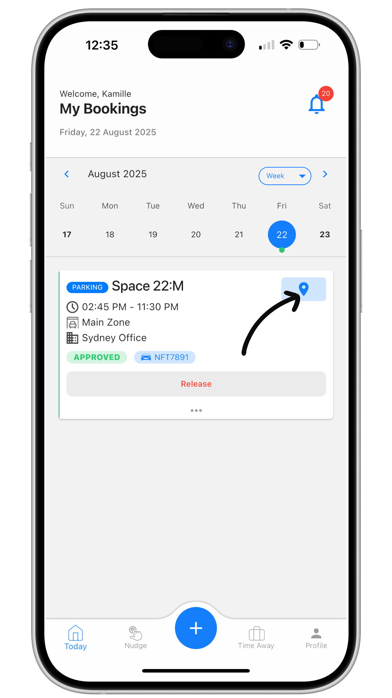
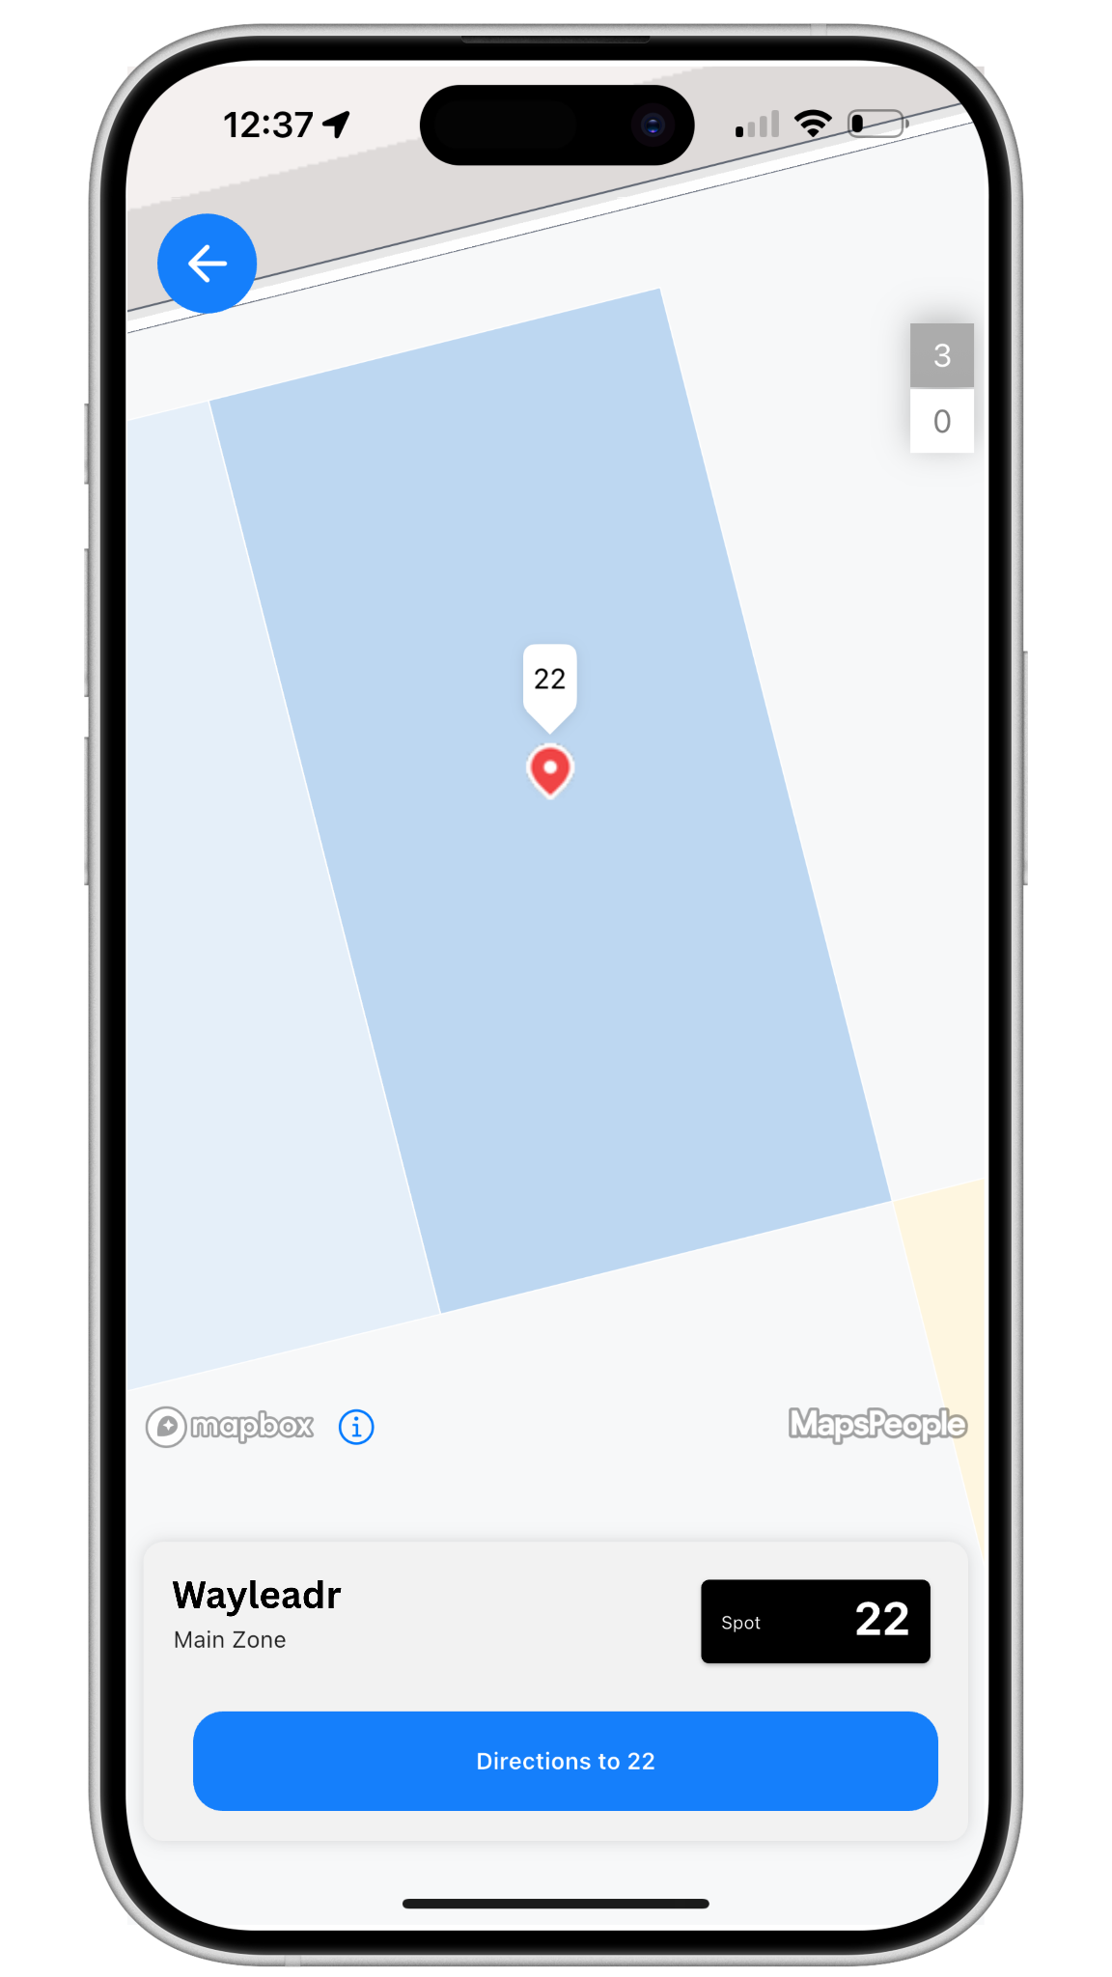
How do I find my space?
On the Wayleadr mobile app, click the Map icon on your approved booking, to see a map view of the carpark and the location of your space.
Click Get Directions to be routed directly to your spot.

Slide 7
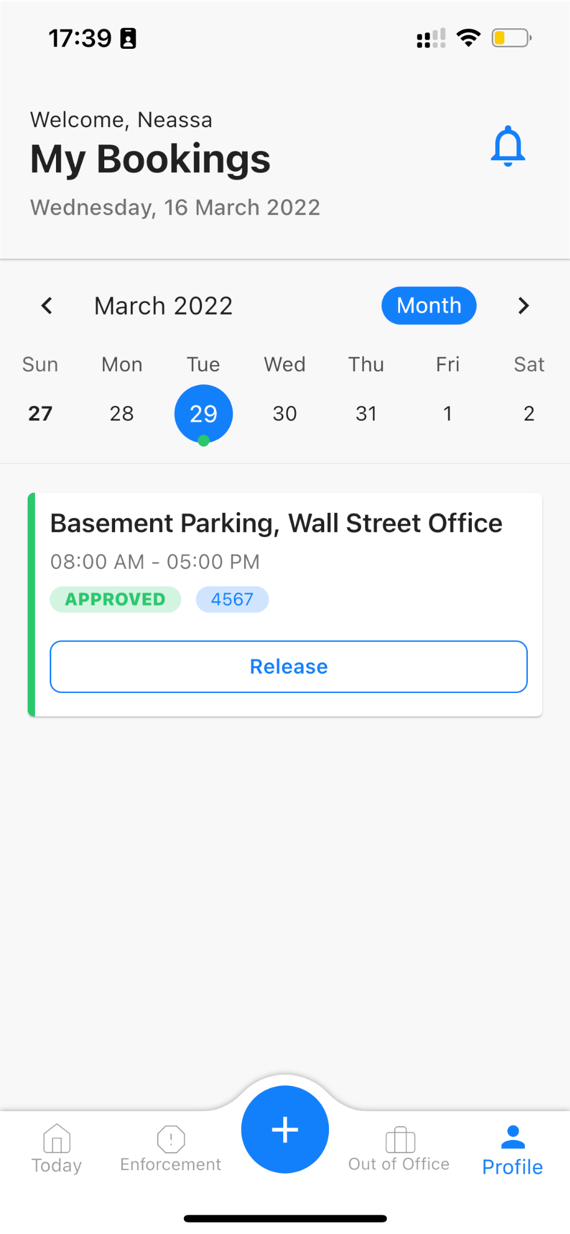
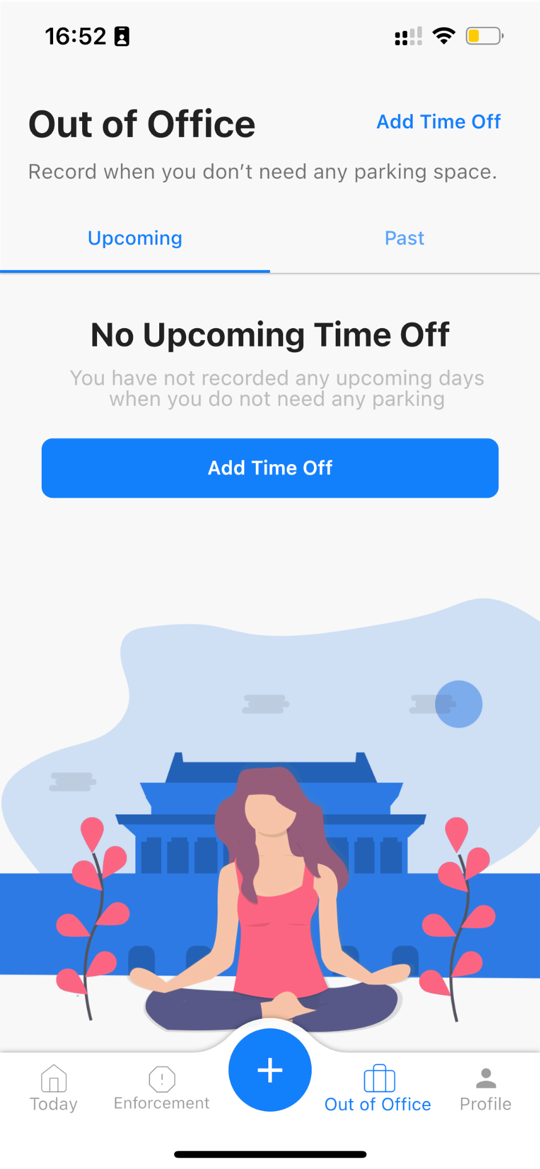
How do I release my space?
If for any reason, you will not be using your space on a given day you can release your spot. This will make it available for another parker to use.
If you are going to be away for a prolonged period, you can use the Time Away feature to release your spot on multiple days in one go.
Released bookings will have a Released tag.
www.wayleadr.com

Slide 8
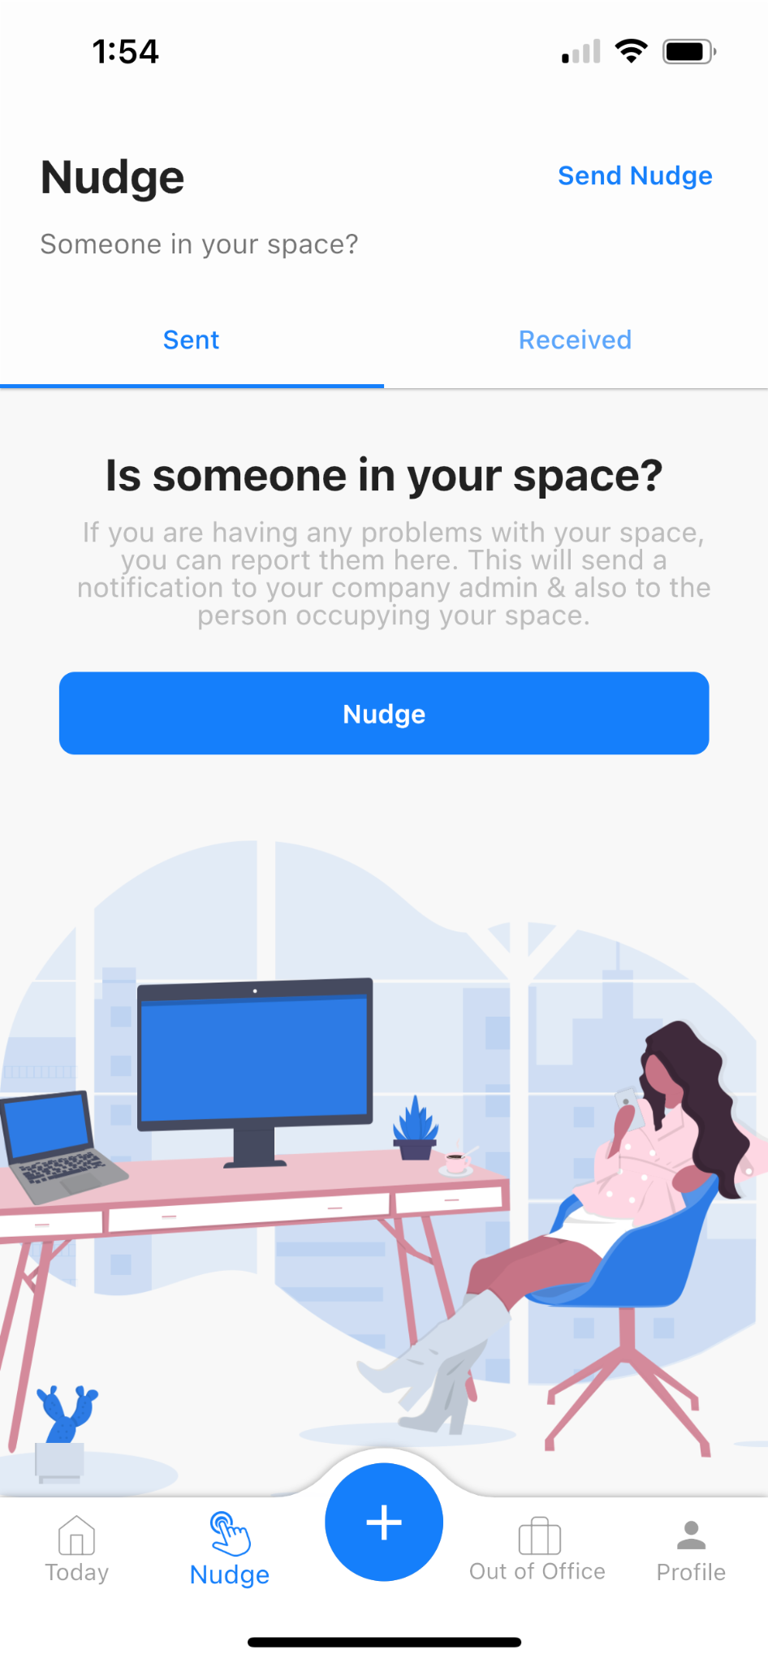
What if I need to report a parking issue?
Select the “Nudge” button
Click “Send Nudge” and select the Nudge Reason
Someone is in my Space can be used if you have an assigned space.
Include the vehicle plate number and a short description of the issue and click “Nudge”
Both the vehicle owner and your company’s Admin will be notified immediately
If there is any space available you will be redirected to a new space. You will immediately get notified on your Wayleadr app and receive an email notification.
Need to move my car can be used if there are tandem spaces at your garage
“ Other” can be used to report any other type of parking issue to the Transportation team
Read more about Nudge here.
www.wayleadr.com

Slide 9
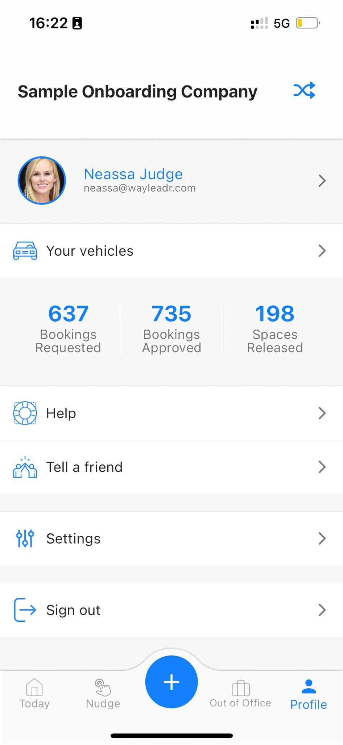
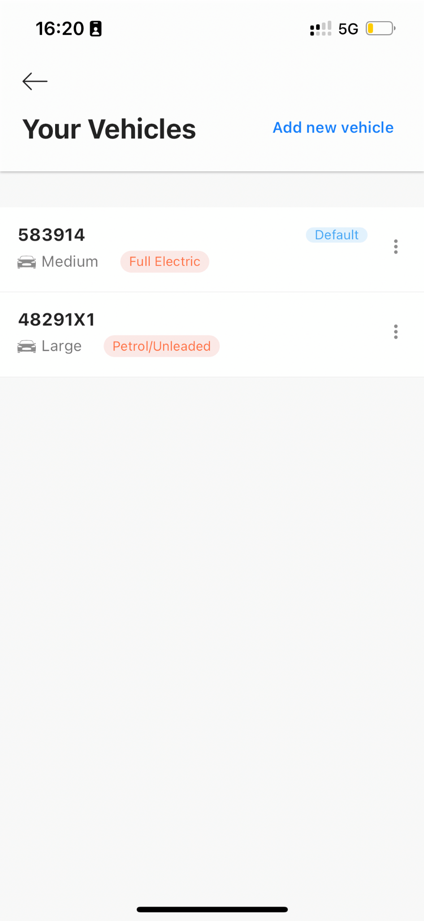
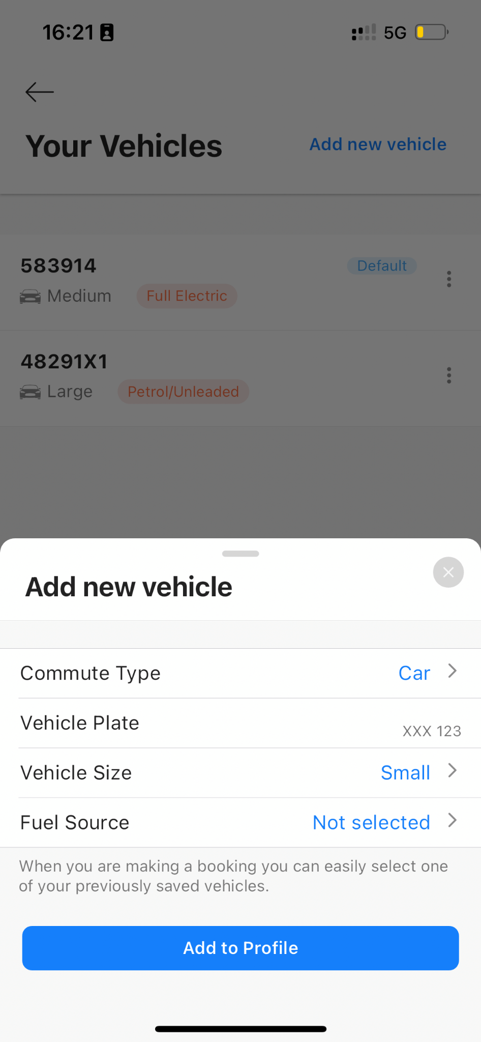
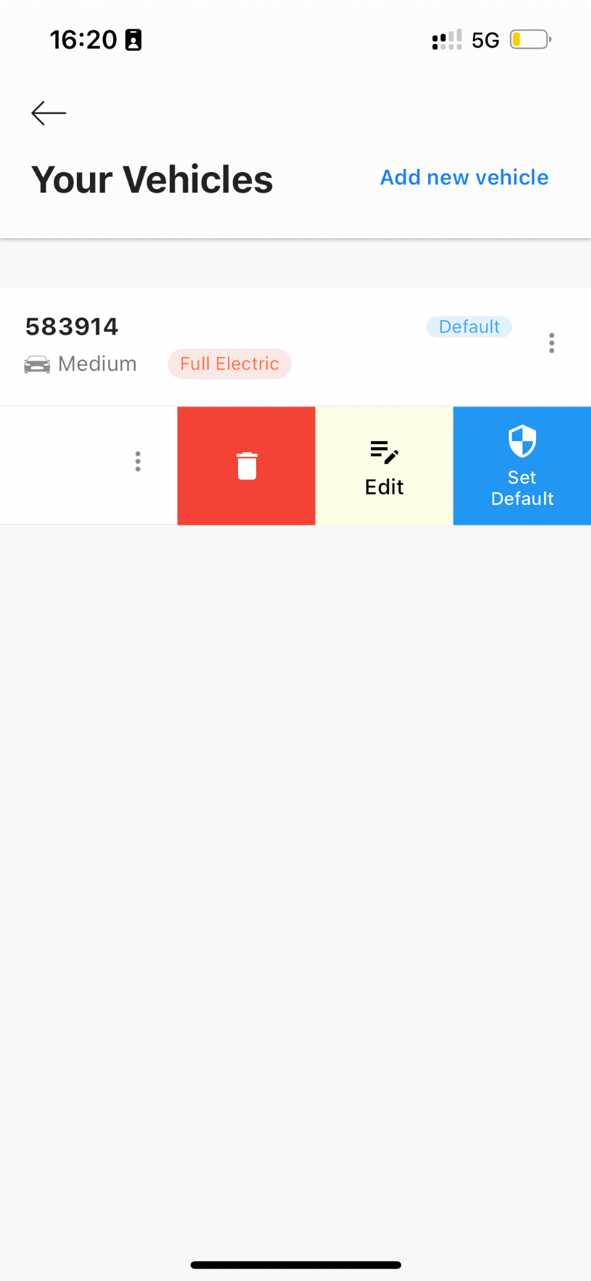
Managing your vehicles
Ensure you have the correct vehicle(s) registered at all times.
www.wayleadr.com

Slide 10
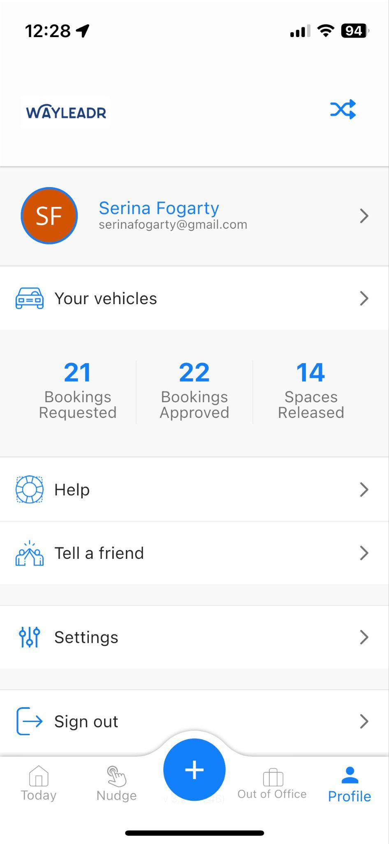
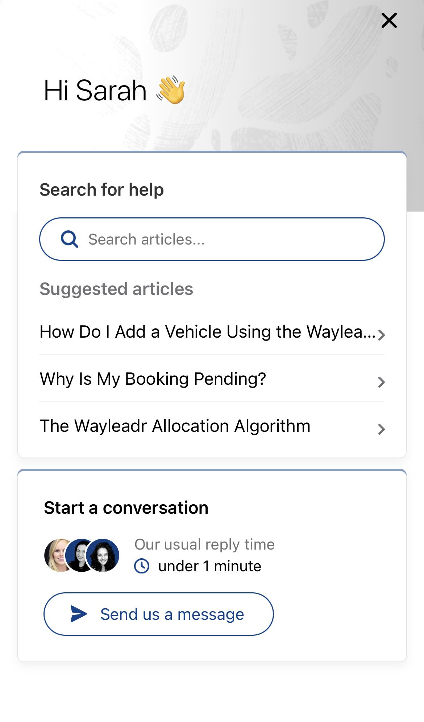
Support
Need More Help?
For app issues, contact Wayleadr’s in-app support or email support@wayleadr.com
Check out Wayleadr’s own FAQ section, accessible through the ‘Help’ section on the app.
For parking program concerns, email LGWCustomerServices@cae.com
www.wayleadr.com

