Slide 1
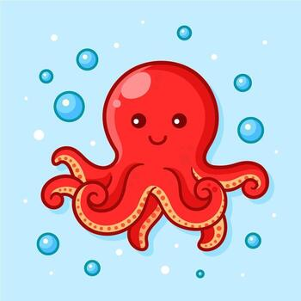
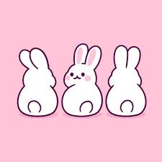
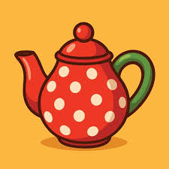
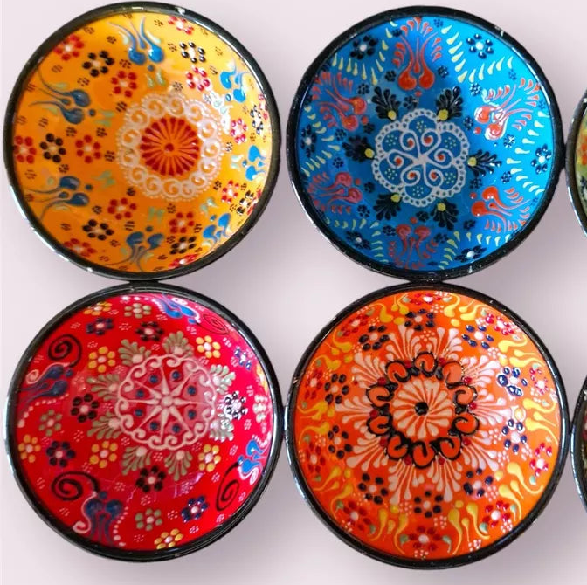
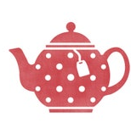

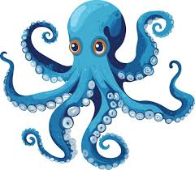
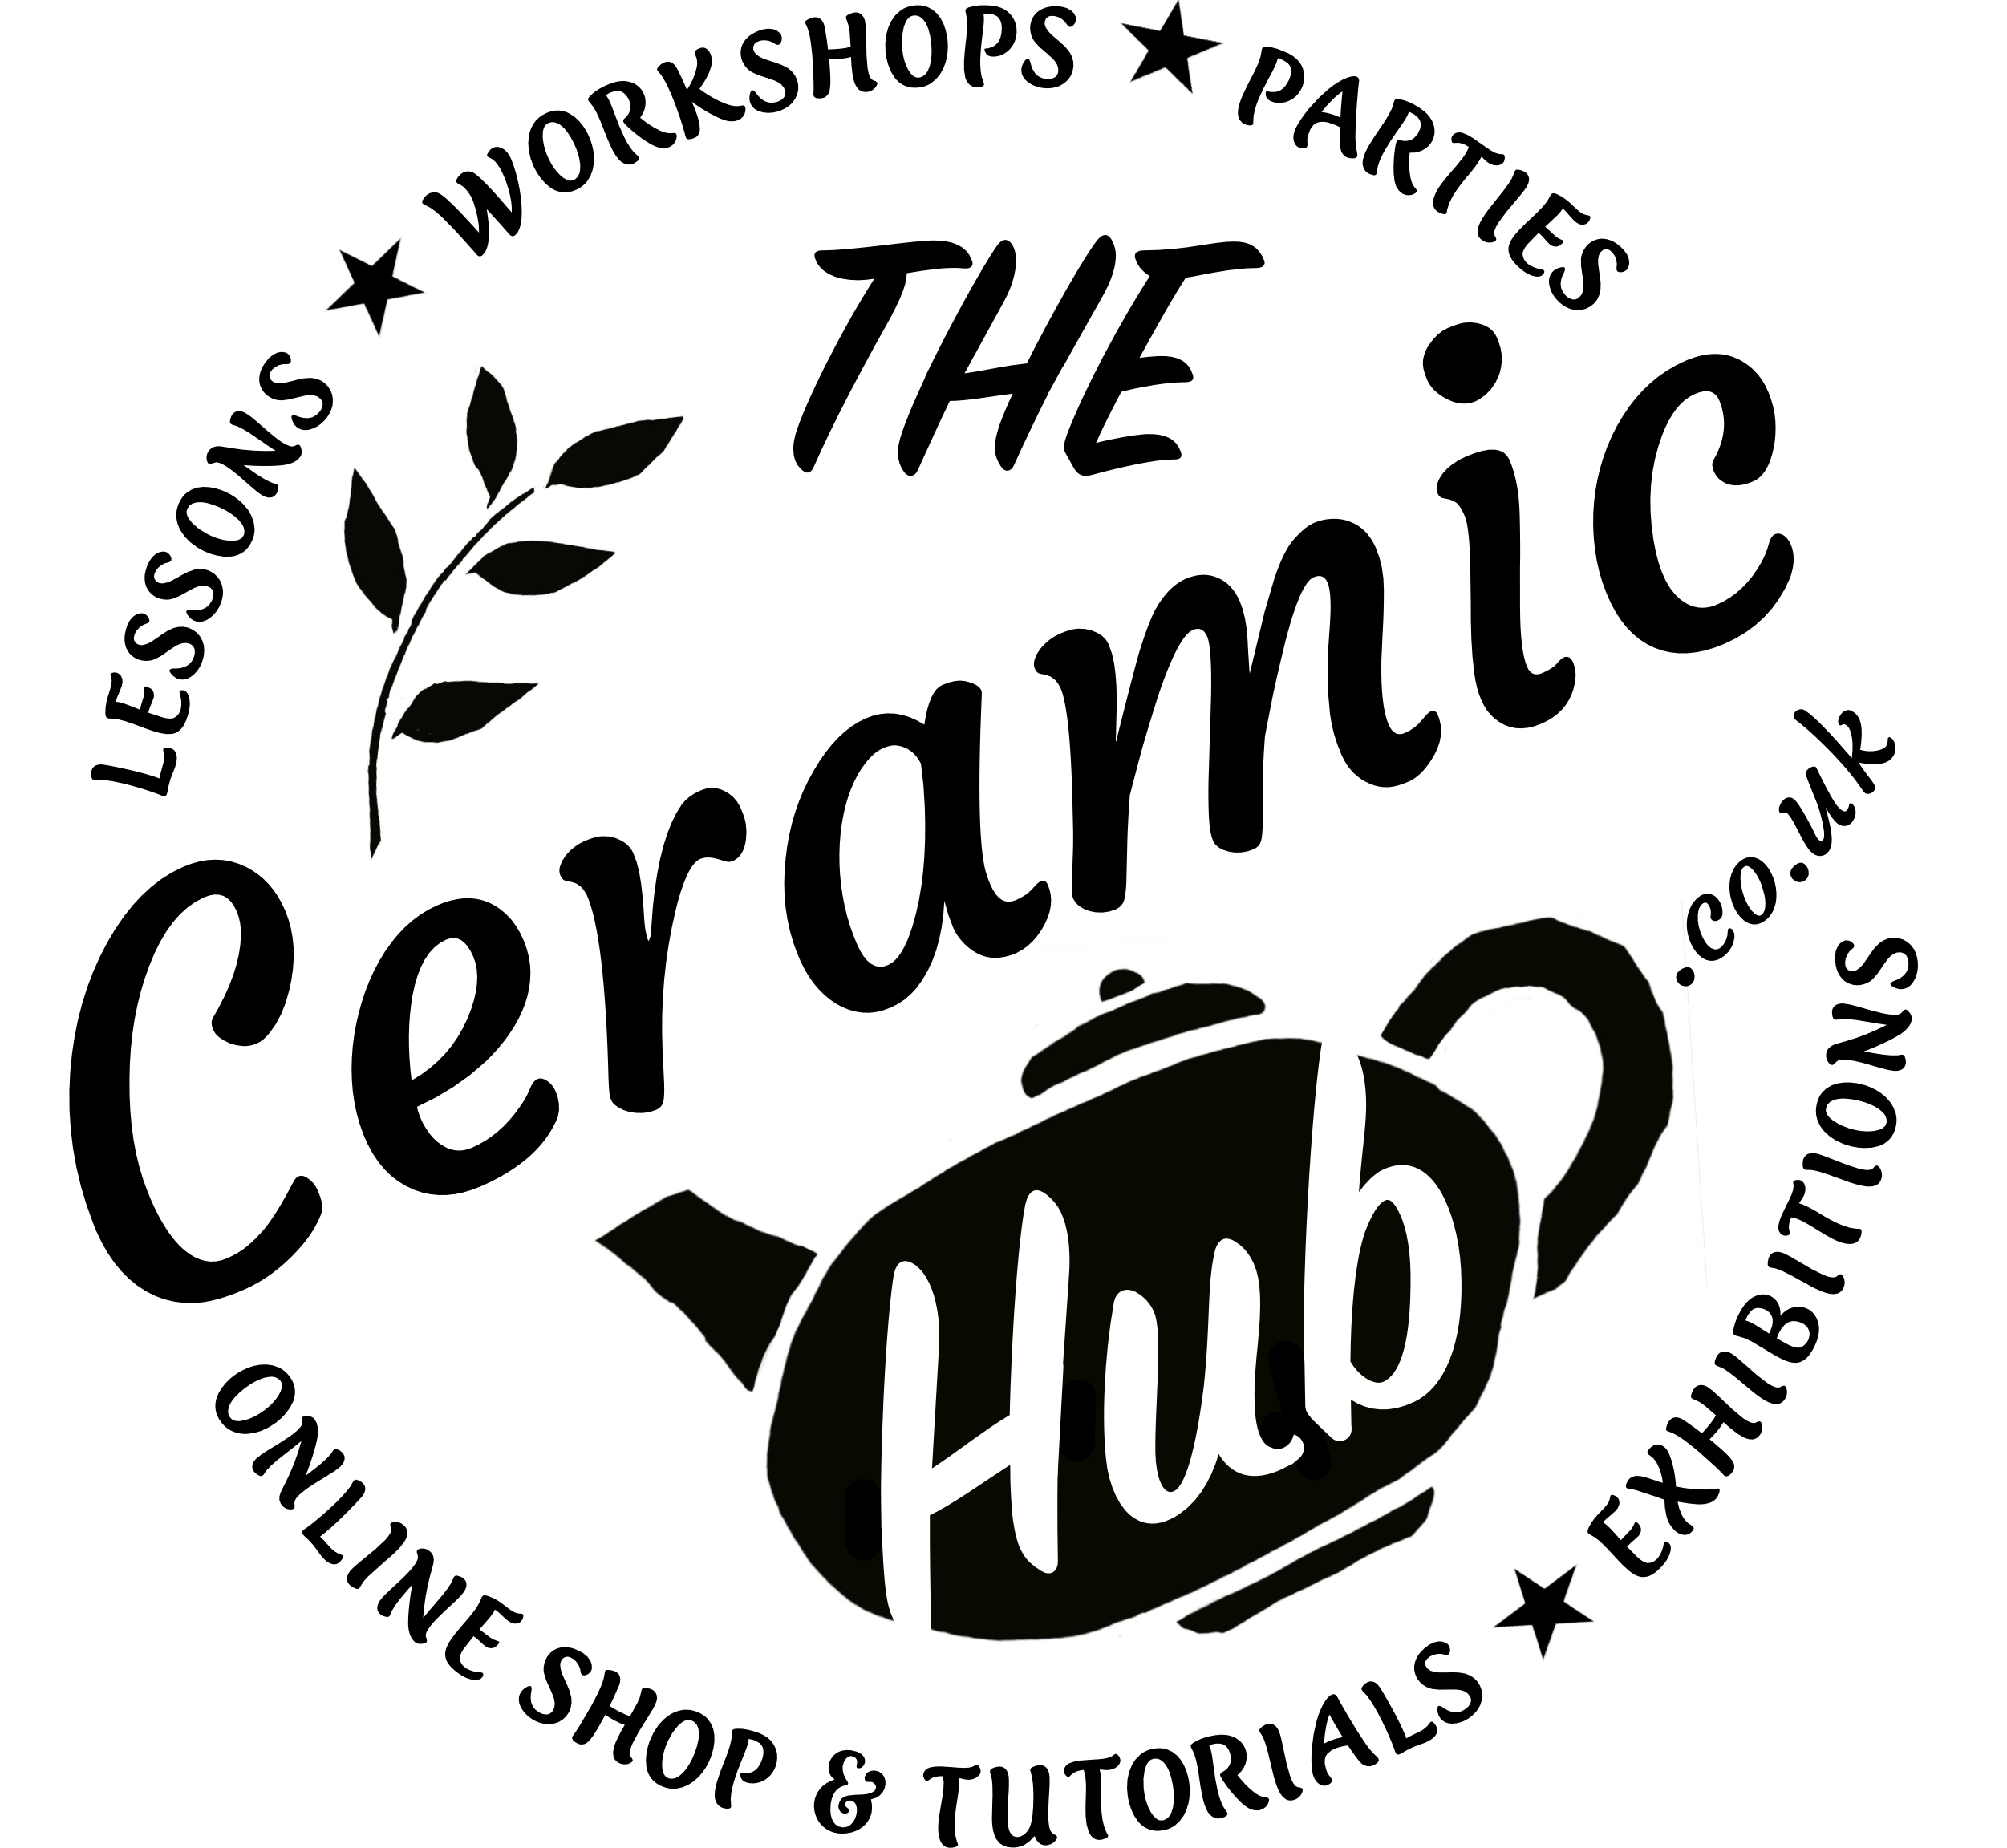
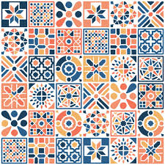
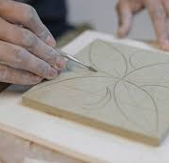
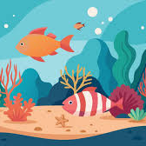
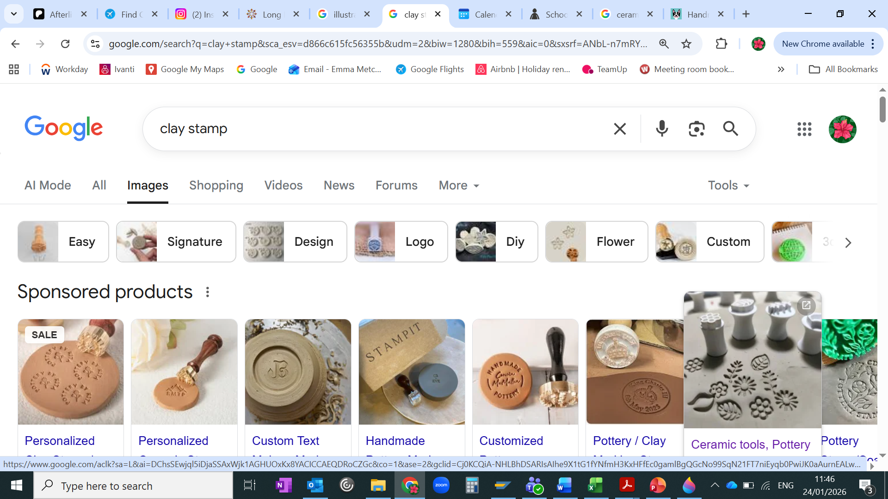
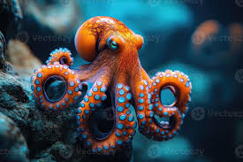
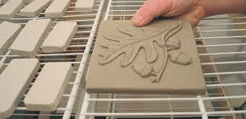
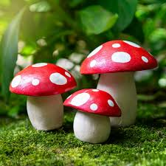
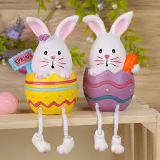
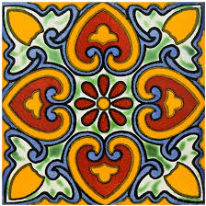
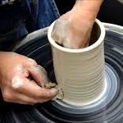
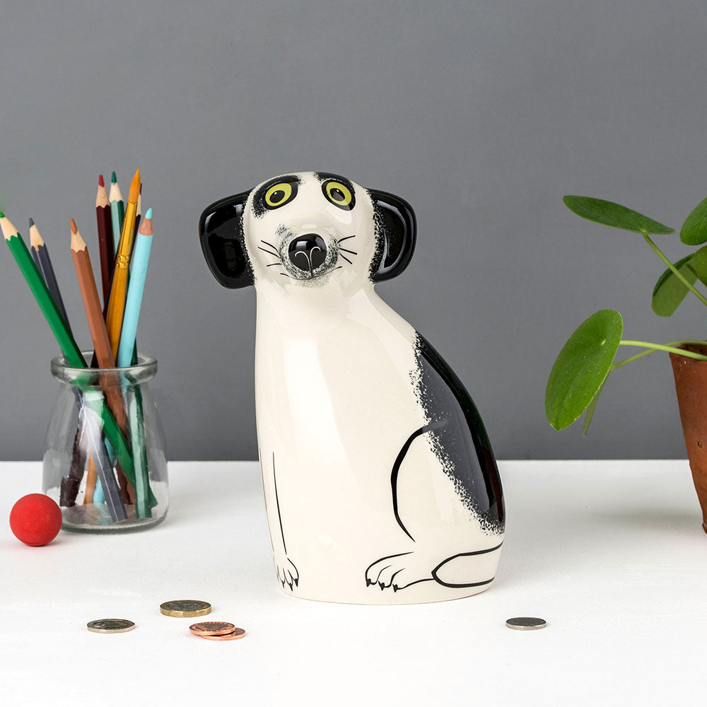
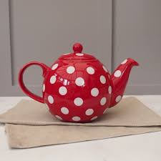
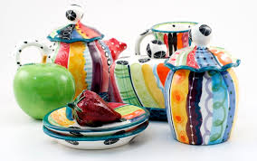
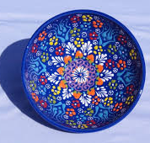
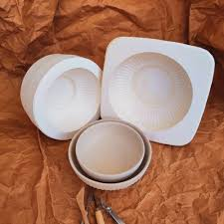
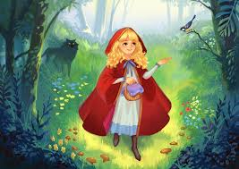
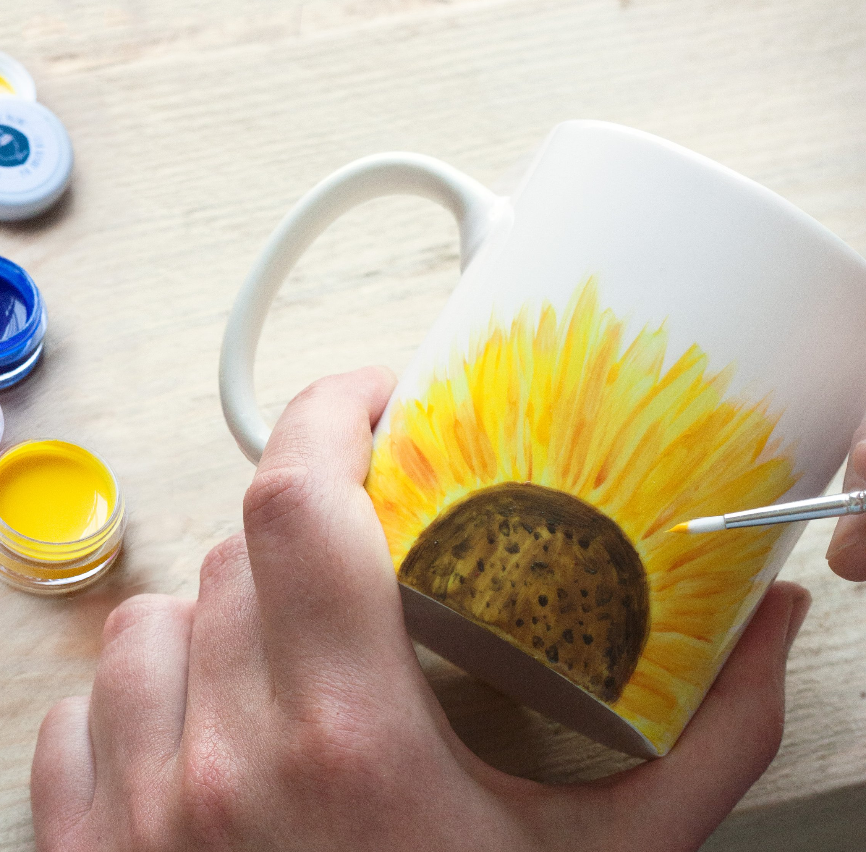
Teapots/teapot house
Pottery Programme - Summer Term 2026
Week 1: Underwater World
Think wiggly fish, slippery octopuses, textured coral, bubbly bubbles and twisty seaweed to inspire your work.
Week 2: Making an Impression
Decorating clay using stamps, natural things and found objects. Or make a logo stamp to sign your pieces.
3D printer for stamps? Create own pottery stamp
Week 3: Tile making
Techniques for making beautiful, handmade ceramic tiles including creating templates, cutting and drying, and decorating with carving and slip trailing.
Fruit bowl
Week 4: Mushrooms
Because everyone loves a mushroom! Carve scrafitto designs, make a mushroom pot, build a little toadstool house or whatever takes your fancy.
Week 5: Tile decorating
With inspiration from Portugese Azulejos, bright Mexican patterns, Indian mandalas and geometric Islamic designs
Week 6: Wheel throwing
Fun, mindful and possibly messy! Learn how to centre, shape and finish beautiful handmade bowls, pots and vases.
Week 7: Pet portraits
Immortalise your furry friends, or make a portrait of a friend’s pet – a perfect gift.
Week 8: Teapots
Learn how to make the key components (body, lid, spout, handle) and assemble them to create a completely unique, functional piece.
Mandalas
Week 9: Turkish glazing
Decorate your thrown pottery treasures using traditional Turkish decorative glazing techniques
Week 10: Plaster moulds
That satisfying feeling when your perfectly smooth work pops out! Learn how to use plaster moulds to make professional-looking pieces.
Round the World – whole term?
Week 11: Fairytales
Create a piece inspired by your favourite fairytale – or other book of your choice.
Week 12: Final glazing
Choose from our massive selection of glazes to put the finishing touches to any of your pieces from the term.
Easter bunnies

